Slide 1
Basics of API Testing
Saurabh Kandhway

Slide 2
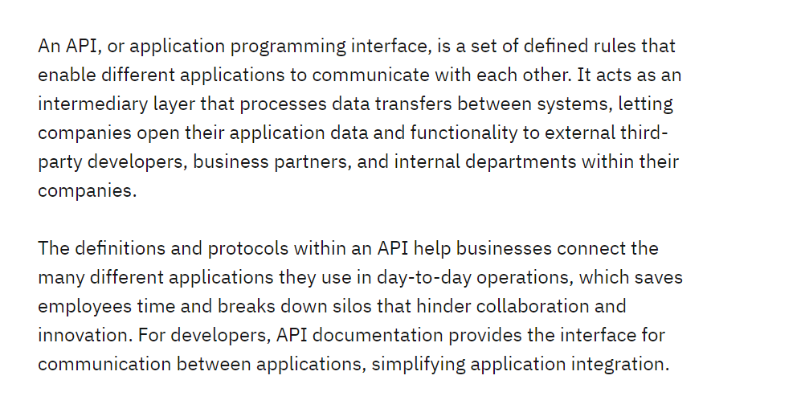
What is an API

Slide 3
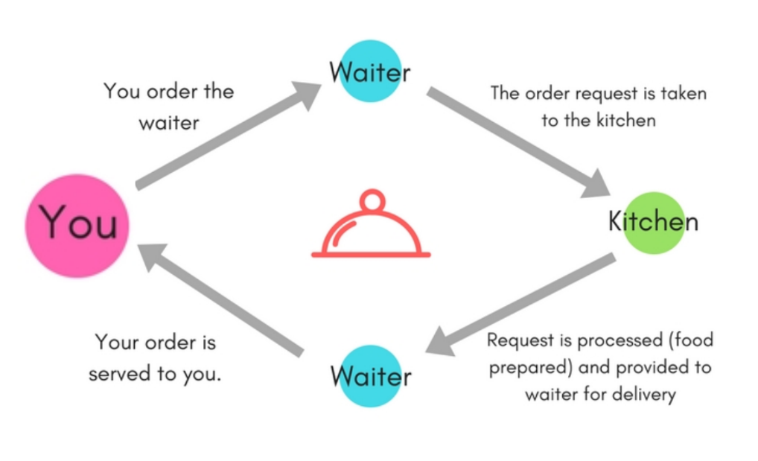
How API Actually Works

Slide 4
Why is API Testing Important
It is important because APIs are the backbone of modern applications and ensure that the different components of the application communicate with each other correctly.
It ensures that the application programming interface (API) performs as expected and fulfills user needs. Through this testing, testers can detect defects and issues in the API, such as incorrect data formats, erroneous responses, or security flaws. Seeing such problems early in the development process allows developers to address them before they become more complex and take longer to resolve.

Slide 5
What are the API Methods
Get Request

Slide 6
API Methods
POST Methods

Slide 7
API Methods
PUT Request
Delete Request

